Slide 1
ASP.NET MVC
Lesson 6 Security

Slide 2
Security
Contoso University
Data Migrations
Users and Roles
Authentication
Authorization
Areas

Slide 3
HoW?
Part 1: from scratch
Part 2: using templates
Without Bootstrap (focus on ASP.NET)
Writing Controllers/Views ourselves
Example: MvcMovie
Exercise: MotoGP
With Bootstrap
Scaffolding
Example: Contoso University
Exercise: Music Store

Slide 4
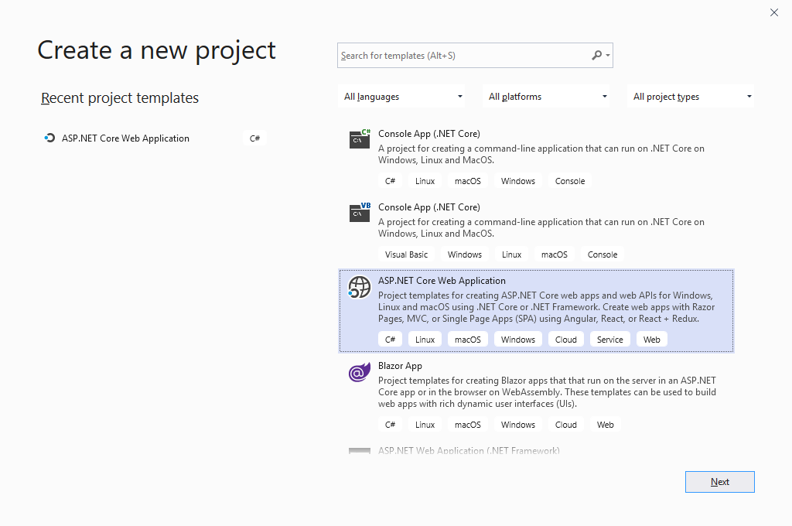
Getting started
Visual Studio
Create a new project

Slide 5
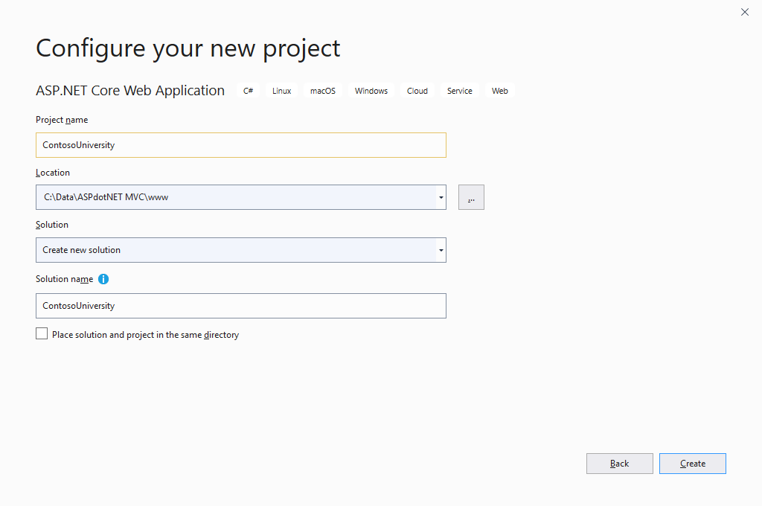
Getting started
ContosoUniversity
Save in your www folder
Create

Slide 6
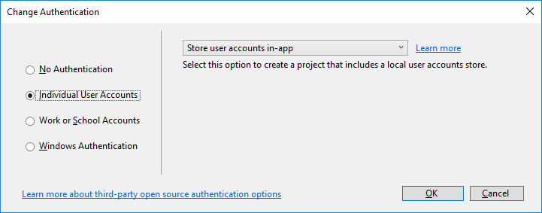
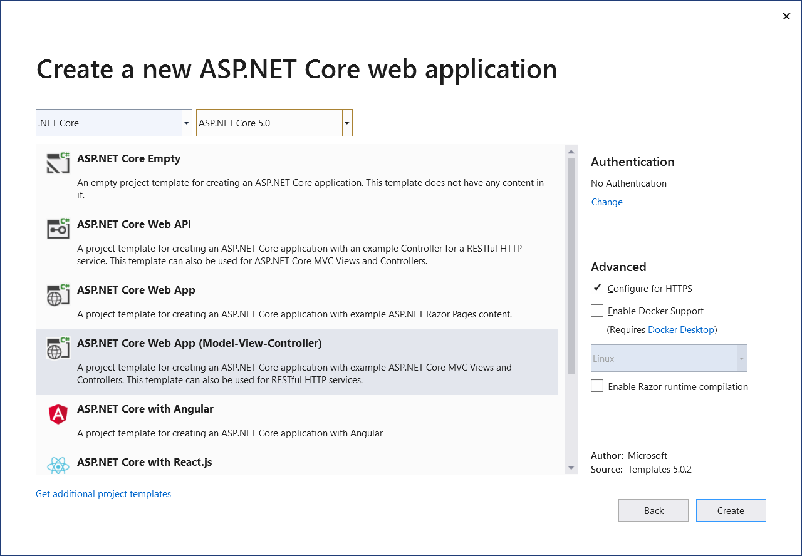
GETTING STARTED
ASP.NET Core 5.0
ASP.NET Core Web App (Model-View-Controller)
Authentication|Change
Indivual User Accounts|OK
Create

Slide 7
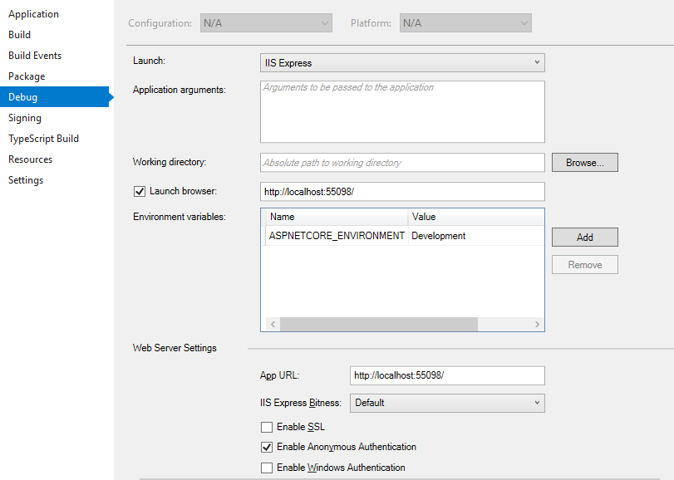
Disable SLL
Just use http instead of https during development (disable SSL)
ContosoUniversity | Right-click
| Properties | Debug

Slide 8
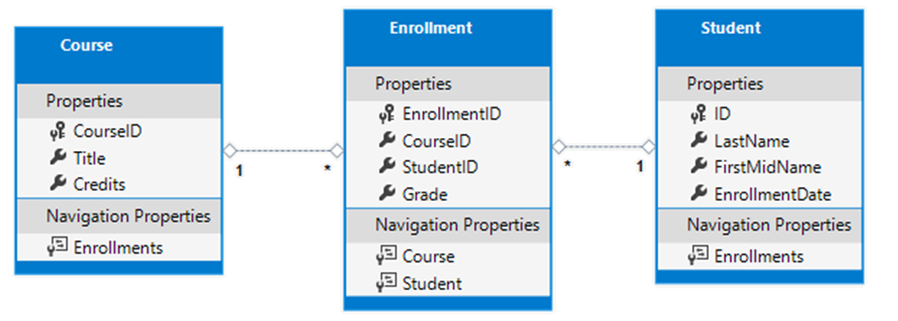
Data Model

Slide 9
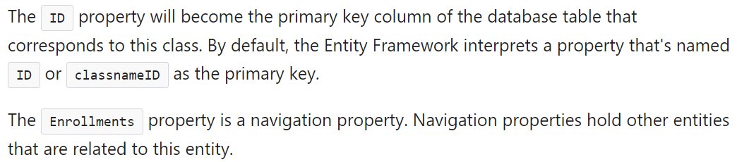
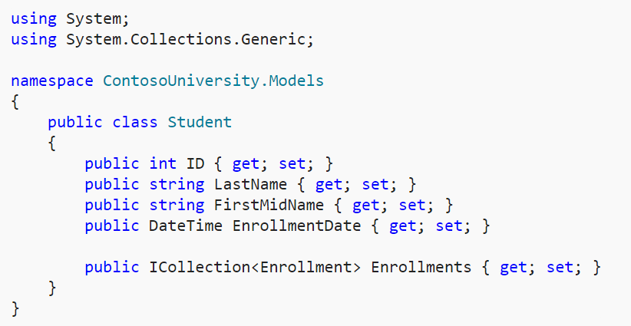
Creating the models (resources oR code-site)
Models
Student.cs

Slide 10
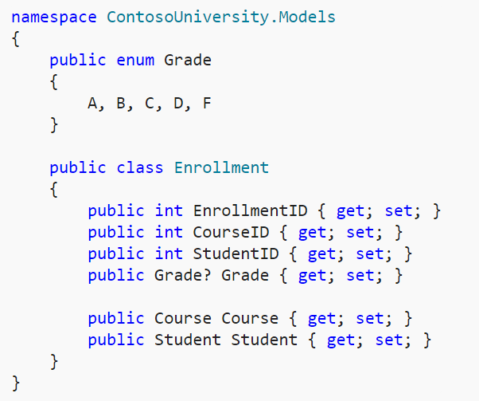
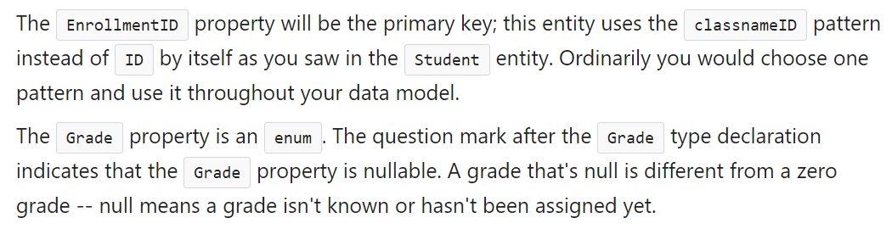
Enrollment.cs

Slide 11
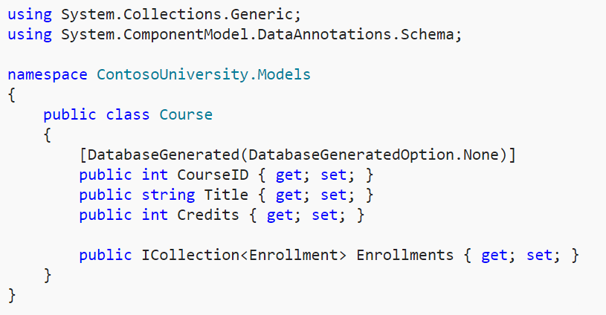
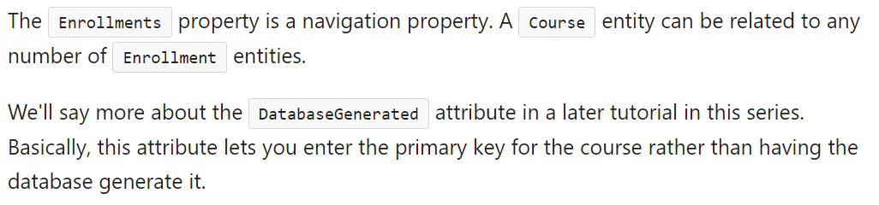
Course.cs

Slide 12
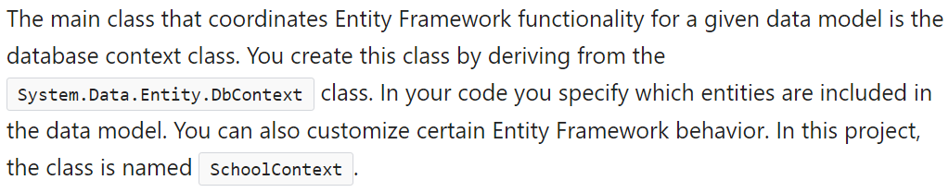
Database Context (resources or code-site)
Data folder
SchoolContext.cs

Slide 13
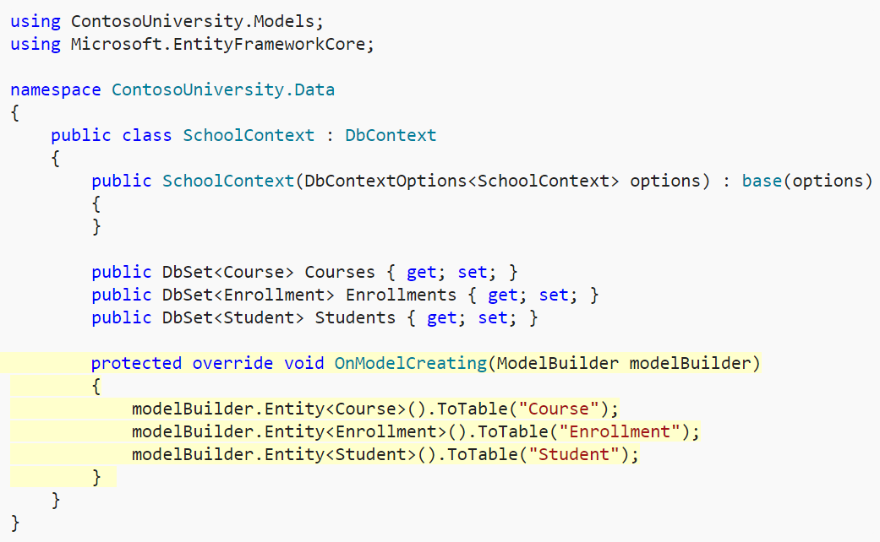
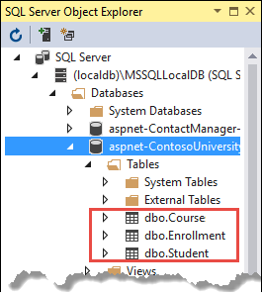
SchoolContext.cs

Slide 14
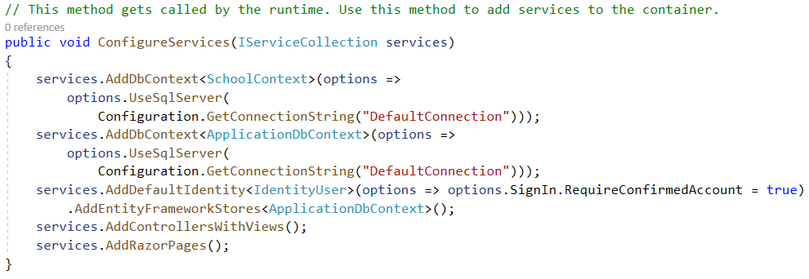
Startup.cs
Register SchoolContext as a service

Slide 15
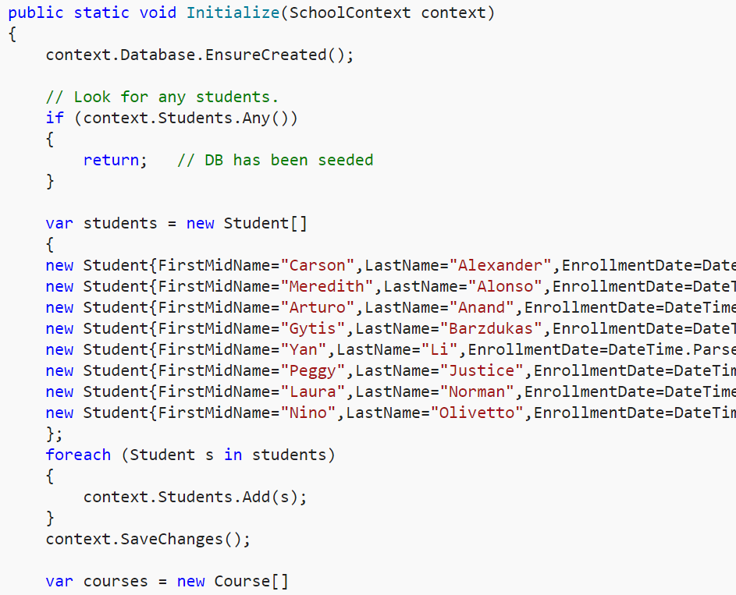
Test Data (resources)
Data folder
DbInitializer.cs

Slide 16
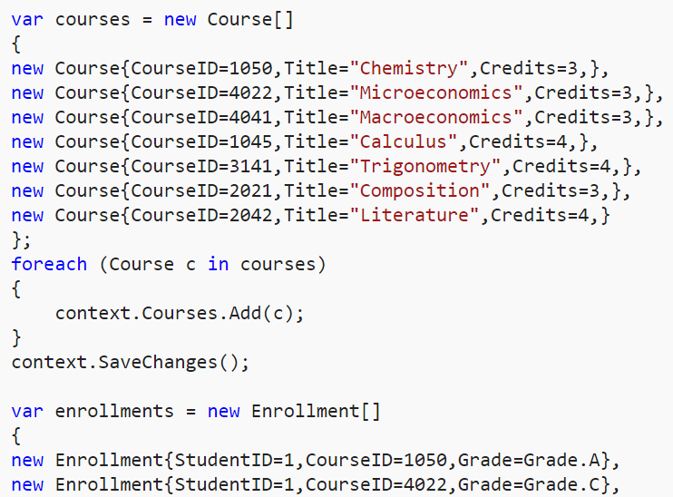
Test Data

Slide 17
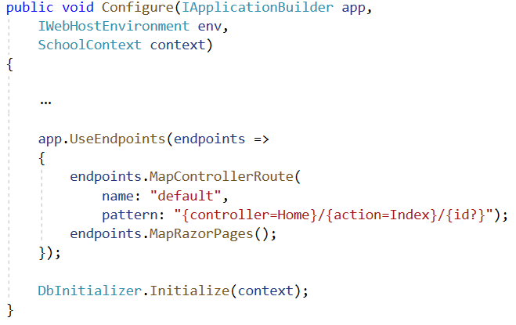
Startup.cs

Slide 18
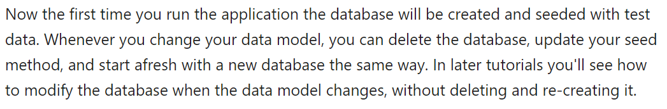
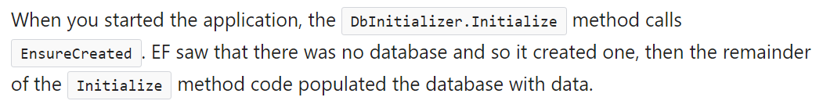
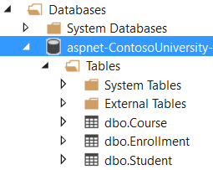
Run The Application (CTRL-F5)

Slide 19
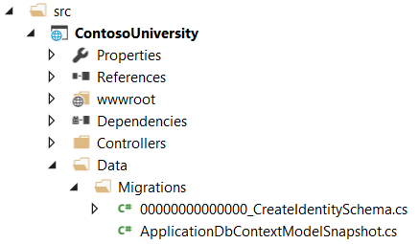
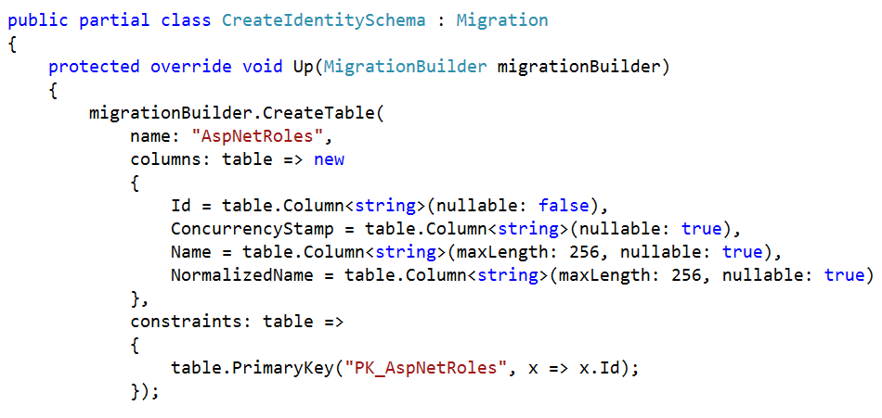
Extra Security Tables
Create the security tables using Data Migrations
Open CreateIdentitySchema.cs
By choosing Individual User Accounts during project creation, this migration script was already created

Slide 20
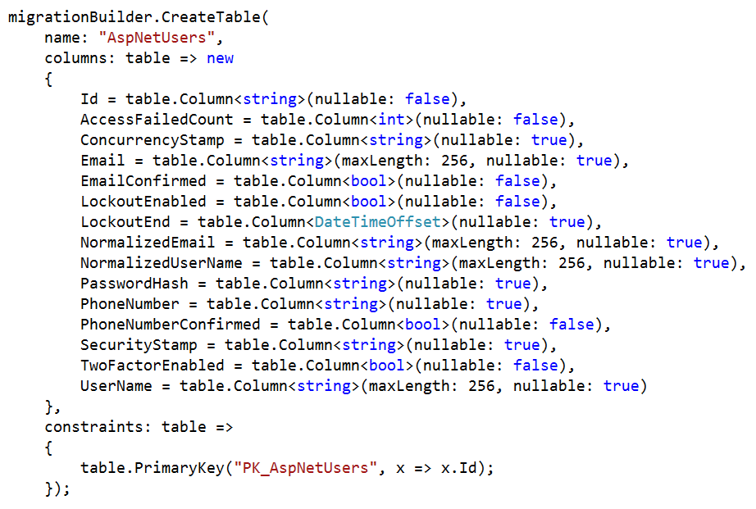
Security Tables

Slide 21
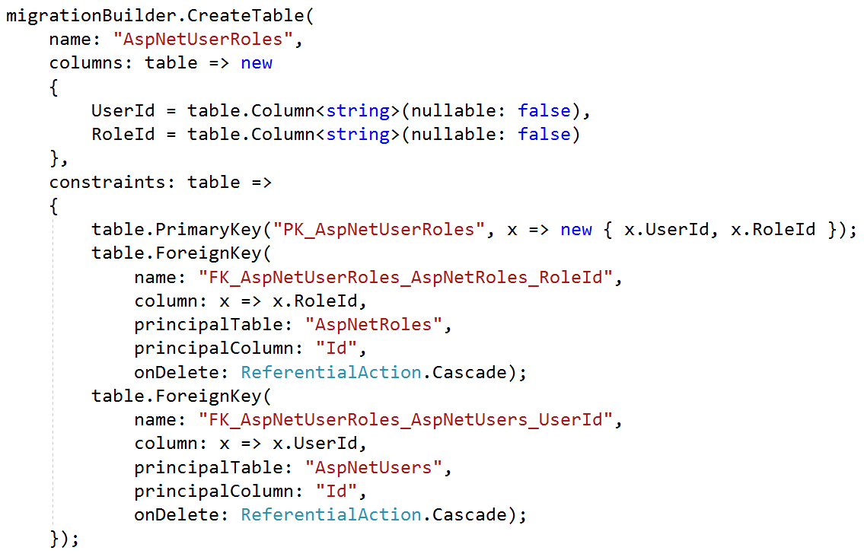
Security Tables

Slide 22
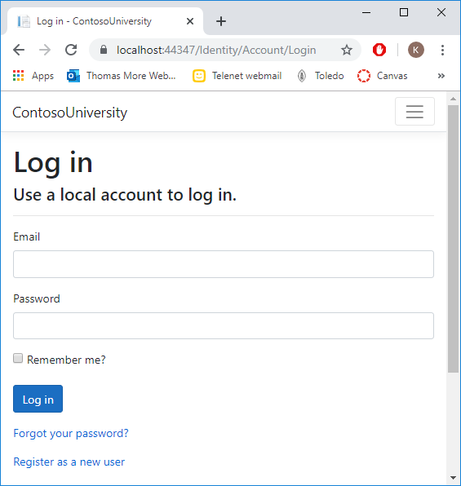
Running the Migration script
Either
via the command prompt (we'll get to that later when talking about Migrations)
by the Contoso University project itself
Login with a dummy account

Slide 23
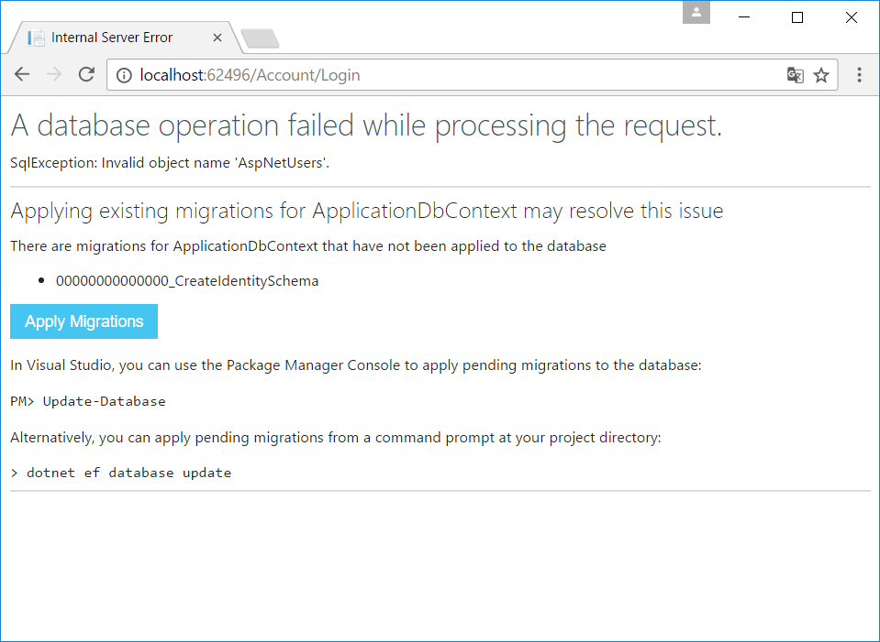
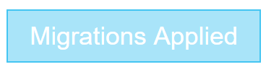
Apply Migrations

Slide 24
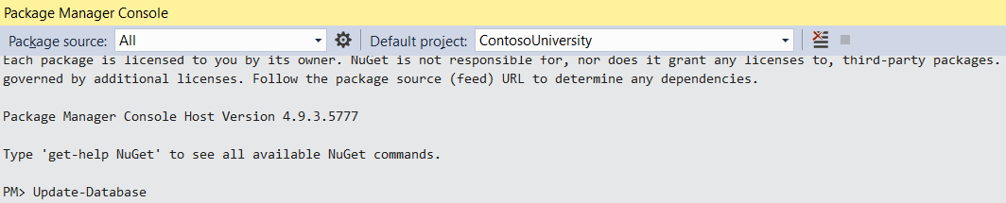
ApplyING Migrations using the Package Manager Console
Open the Command Prompt in Visual Studio
View | Other Windows | Package Manager Console
More on Migrations later in this course

Slide 25
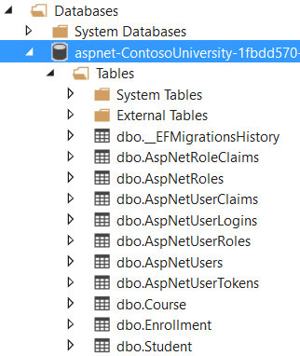
Contoso Database

Slide 26
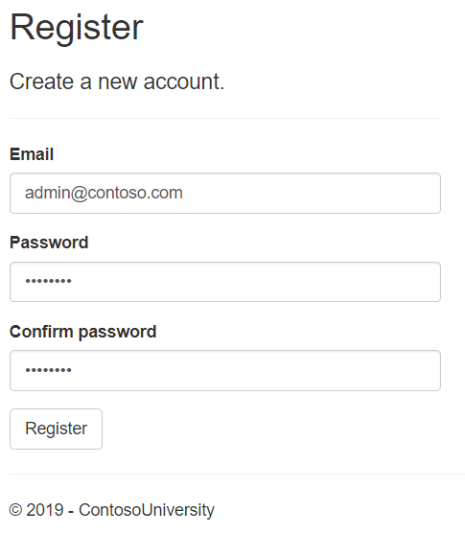
Authentication
Register
admin@contoso.com
C0ntoso.

Slide 27
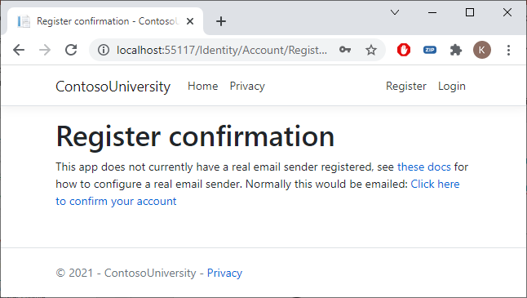
Register Confirmation
Confirm your account

Slide 28
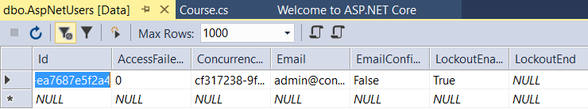
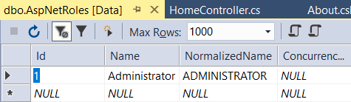
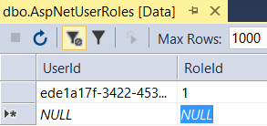
Users - Roles - USerRoles

Slide 29
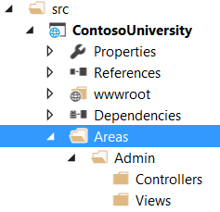
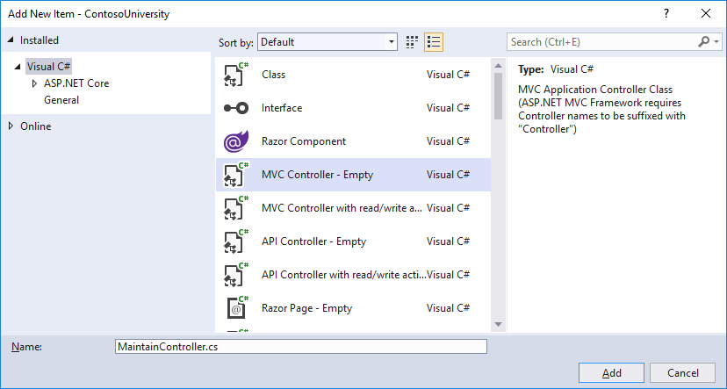
Creating a separate admin area
Areas | Add Folder | Admin
Controllers
Views
Controllers | Add New Item
MaintainController.cs

Slide 30
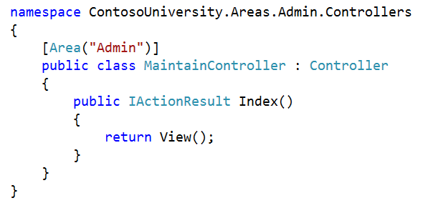
Maintaincontroller.cs

Slide 31
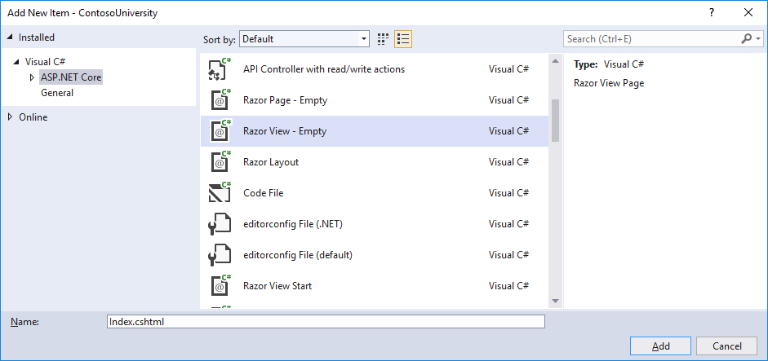
Admin Index View
Views | Add New Folder | Maintain
Maintain | Add New Item
Razor View - Empty
Index.cshtml

Slide 32
Index.cshtml
@{
ViewData["Title"] = "Maintain Page";
}
<h2>@ViewData["Title"]</h2>
<h4>Admin panel</h4>

Slide 33
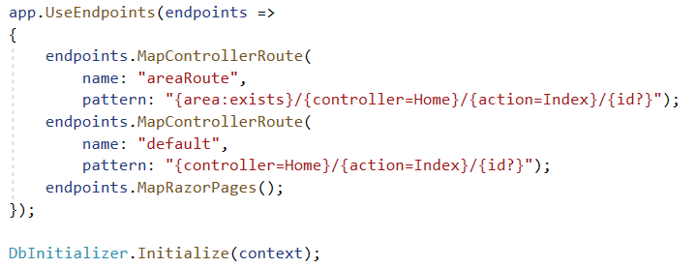
Startup.cs (startup.cs.txt IN resources OR code-site)

Slide 34
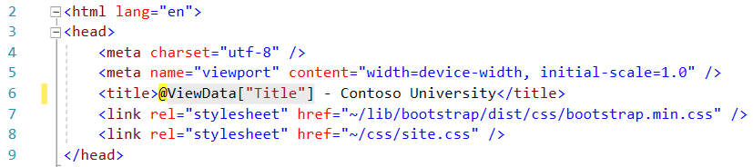
_Layout.cshtml
Change title to Contoso University (3 times)

Slide 35
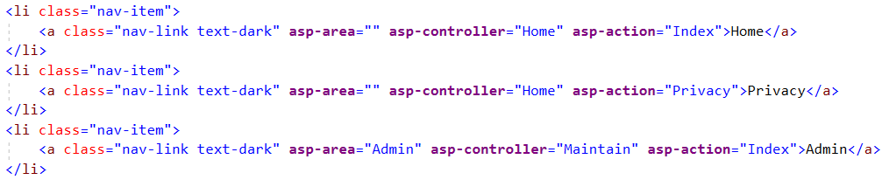
_Layout.cshtml

Slide 36
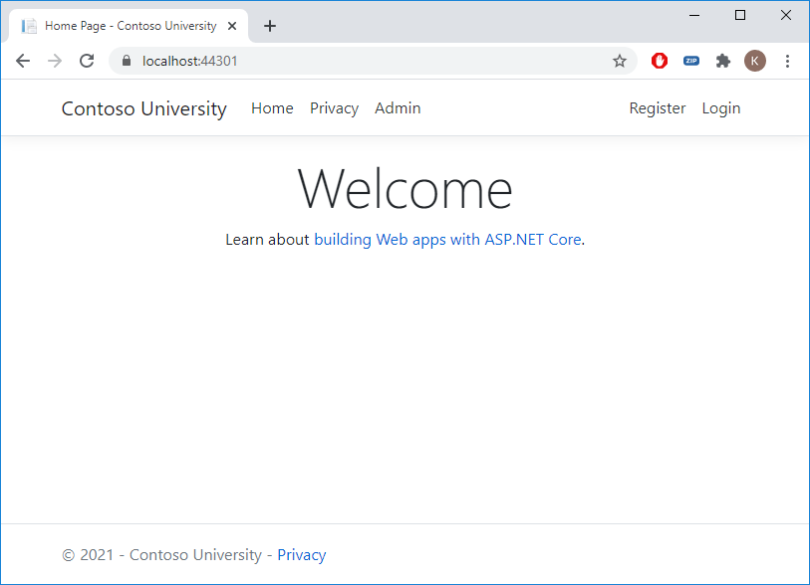
Admin menu

Slide 37
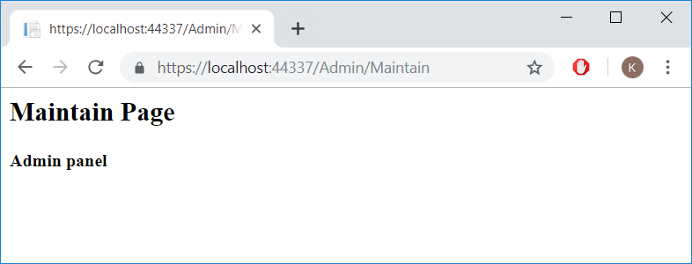
Maintain page
Let's create a layout template for the Admin Area

Slide 38
a layout template for the Admin Area
_Layout.cshtml | Copy
Paste | _LayoutAdmin.cshtml
<li class="nav-item">
<a class="nav-link text-dark" asp-area="" asp-controller="Home" asp-action="Index">Home</a>
</li>
<li class="nav-item">
<a class="nav-link text-dark" asp-area="Admin" asp-controller="Students" asp-action="Index">Students</a>
</li>
<li class="nav-item">
<a class="nav-link text-dark" asp-area="Admin" asp-controller="Courses" asp-action="Index">Courses</a>
</li>
<li class="nav-item">
<a class="nav-link text-dark" asp-area="Admin" asp-controller="Enrollments" asp-action="Index">Enrollments</a>
</li>

Slide 39

A Default Admin pages layout
Areas/Admin/Views
_ViewStart.cshtml (resources or code-site)

Slide 40
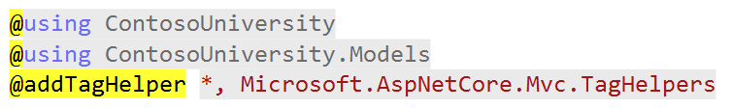
import Tag helpers, … in Admin Views
Areas/Admin/Views
_ViewImports.cshtml (resources or code-site)

Slide 41
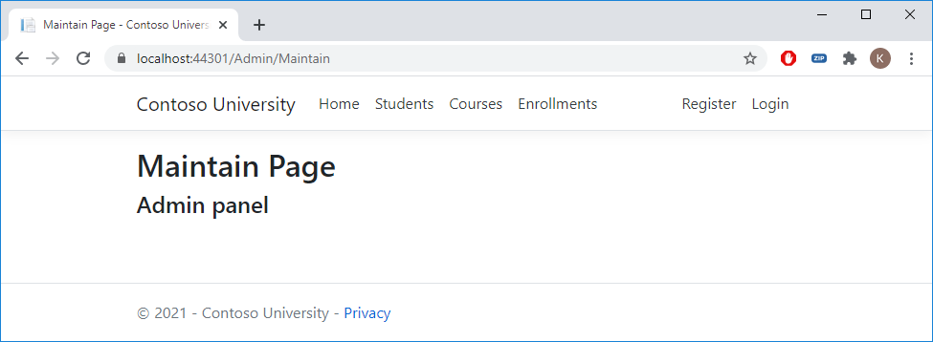
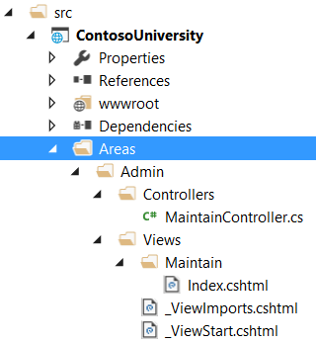
Admin Area
Only access when logged in as administrator?

Slide 42
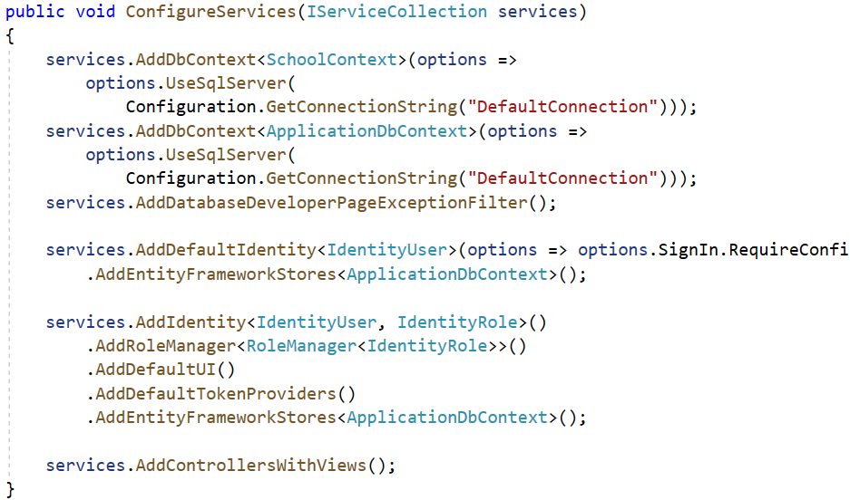
Startup.cs.txt oR code-site

Slide 43
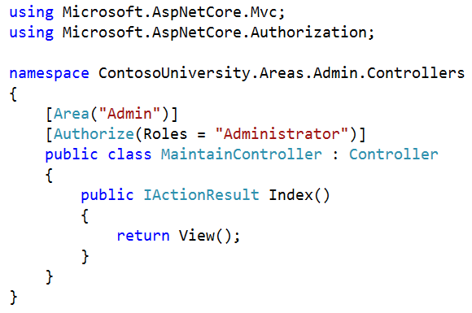
Authorization

Slide 44


Authorization

Slide 45


User without Administrator Role
Logout
Register
user@contoso.com
C0ntoso.

Slide 46
Exercise
Music Store Part 1

